Slide 1
nucleic acid structure
Prof. Thomas E. Cheatham III

Slide 2
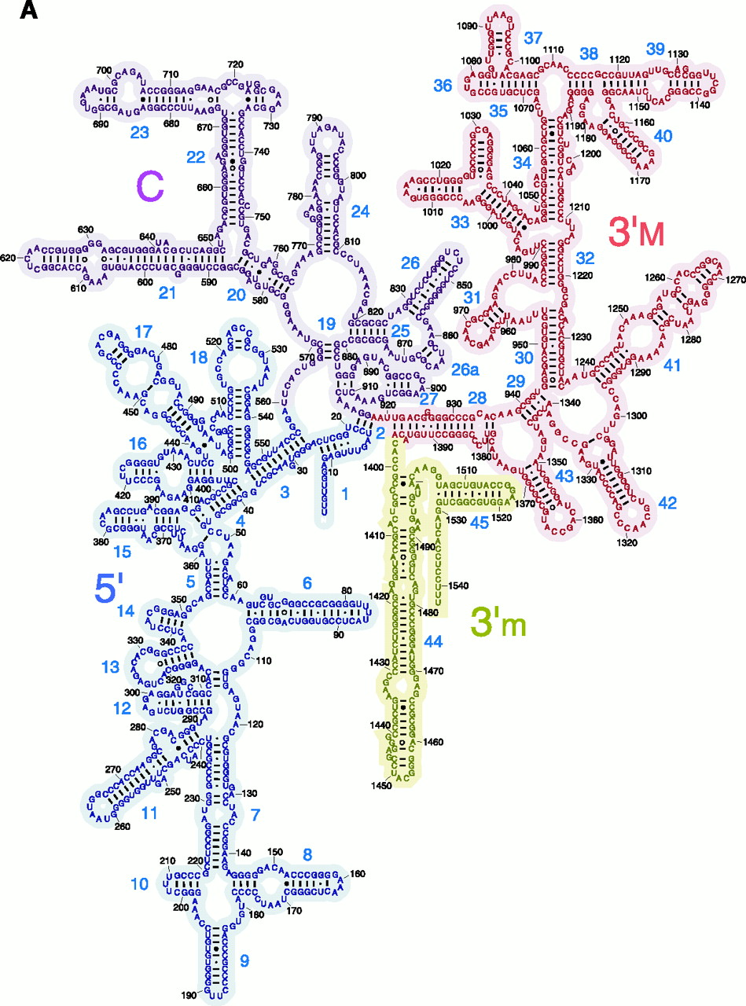
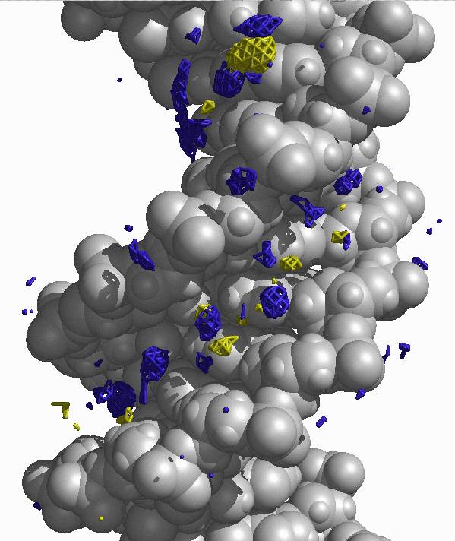
Where art thou nucleic acid?

Slide 3
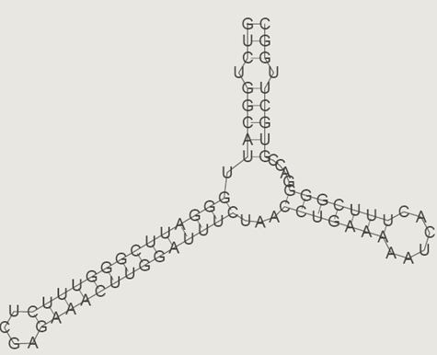
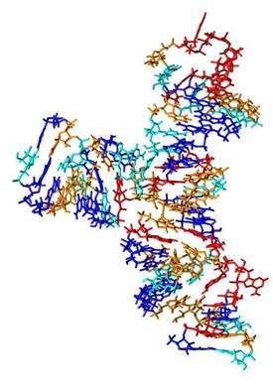
5’-GUCUGGCAUUGGGAUUCGGGUUUCUCAGAAACUUGGAUUUCUAACCUGAAAAAUCACUUUCGGGGACCGUGCUUGGC-3’
?
?
Our long-term goals are to enable the end-stage of nucleic acid structure refinement, to accurately model nucleic acid structure and dynamics, and to probe the interaction of molecules targeting RNA and DNA.
Given a putative RNA model can we refine it?
Can we evaluate its relative importance?
Can we probe the interaction with other molecules / drugs?

Slide 4
A nucleotide has three parts:
Base
NH
2
N
Phosphate
N
O
N
N
-O
P
O
O
O-
H
H
H
H
OH
OH
Sugar

Slide 5
DNA and RNA have different sugars:
Base
NH
2
N
N
Phosphate
O
N
N
-O
P
O
O
O-
H
H
Base
H
H
NH
2
OH
OH
Sugar = ribose
N
N
RNA
Phosphate
O
N
N
-O
P
O
O
O-
H
H
H
H
OH
H
Sugar = deoxyribose
DNA

Slide 6
The sugar-phosphate backbone

Slide 7
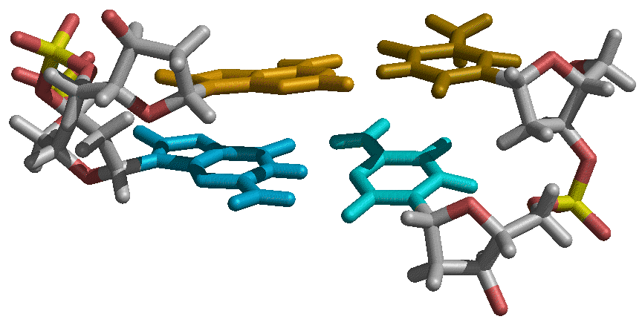
AMBER names and atom types (parm94.dat)
thymine
adenine
O4
N7
N6
N3
N1
N1
N9
N3
O2
C4’
C3’
N7
O2
N4
N9
03’
N1
N3
N3
N2
C2
N1
O4’
P
guanine
O2
C1’
C5’
cytosine
C4’
C2’
C3’
O2’

Slide 8
Sugar puckering
Various sugar ring puckering conformations. Those on the left are denoted S (for
south); those on the right, N (for north). The C3′-endo conformation is seen at the top right, and the C2′-endo conformation at the top left. The notation of E and T conformations is also given

Slide 9
Sugar puckering

Slide 10
Purines and pyrimidines

Slide 11
The glycosidic torsion parameter

Slide 12
Watson-Crick base pairing

Slide 13
A-DNA and B-DNA form helices

Slide 14
Base stacking

Slide 15
Base pair and base pair step helicoidals

Slide 16
Moving on to RNA
The two types of sugar pucker most commonly found in nucleic acids. The
C3′-endo pucker is prevalent in RNA and A-form DNA, whereas the C2′-endo pucker is characteristic of B-form DNA. It is seen that the C3′-endo pucker produces a significantly shorter phosphate-phosphate distance in the backbone, resulting in a more compact helical conformation.

Slide 17
RNA has more base pairing possibilities
(DNA also has alternative base pairs)
Left: Canonical Watson–Crick GC base pair (cis). Right: GC reverse Watson–Crick
base pair (trans).

Slide 18
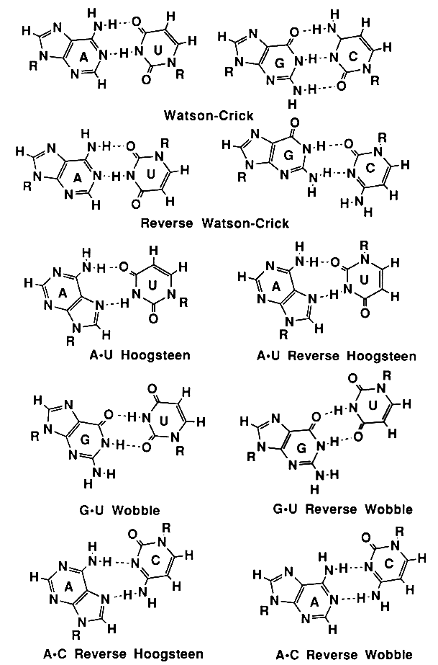
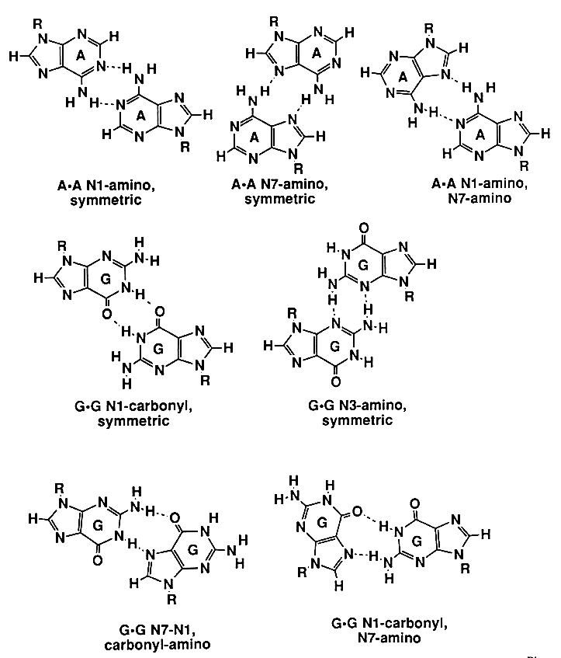
Structures of base pairs involving at least two hydrogen bonds. The 28 possible base pairs that involve at least two hydrogen bonds as compiled by I. Tinoco Jr. Watson-Crick, Reverse Watson-Crick, Hoogsteen, Reverse Hoogsteen, Wobble, Reverse Wobble
The ten possible purine-pyrimidine base pairs
The seven possible homo purine-purine base pairs

Slide 19
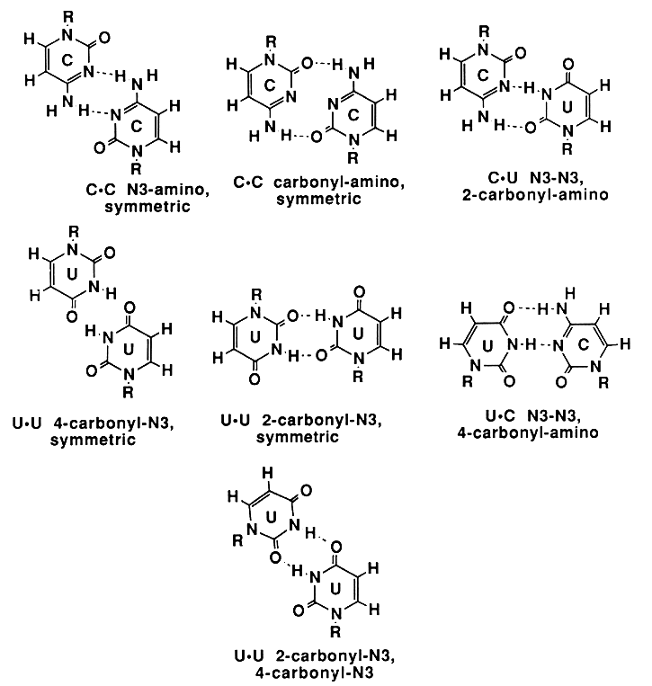
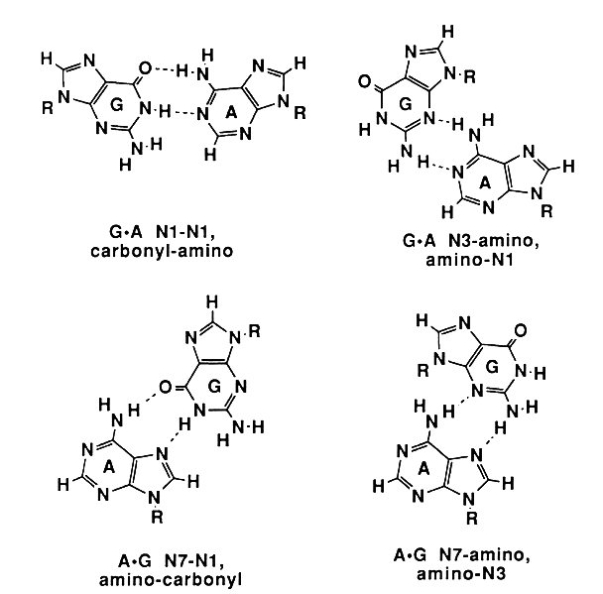
The seven possible pyrimidine-pyrimidine base pairs
The four possible hetero purine-purine base pairs
Ignacio Tinoco, Jr. in Gesteland, R. F. and Atkins, J. F. (1993) THE RNA WORLD. Cold Spring Harbor Laboratory Press.

Slide 20
cisWCWC
cisHH
cisWCSh
transWCH
transHSh
cisWCH(a)
transWCWC
cisWCH(b)
transHH
Single H-bonded A-A base pairs
transWCSh

Slide 21
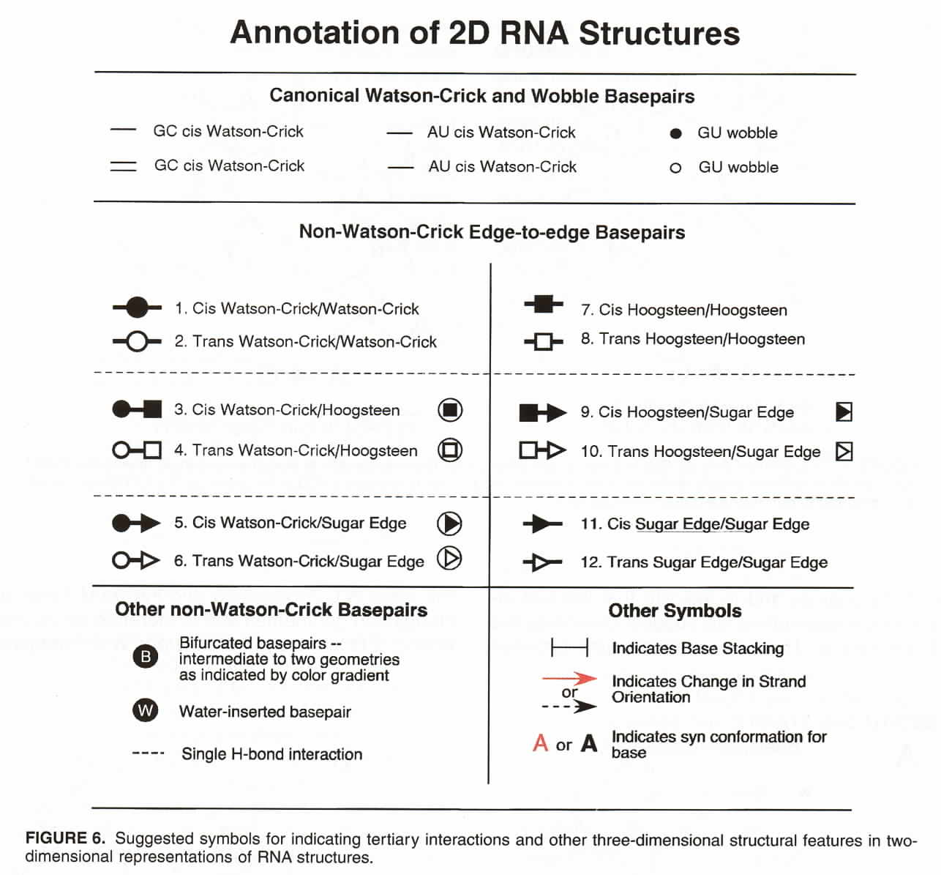

Slide 22
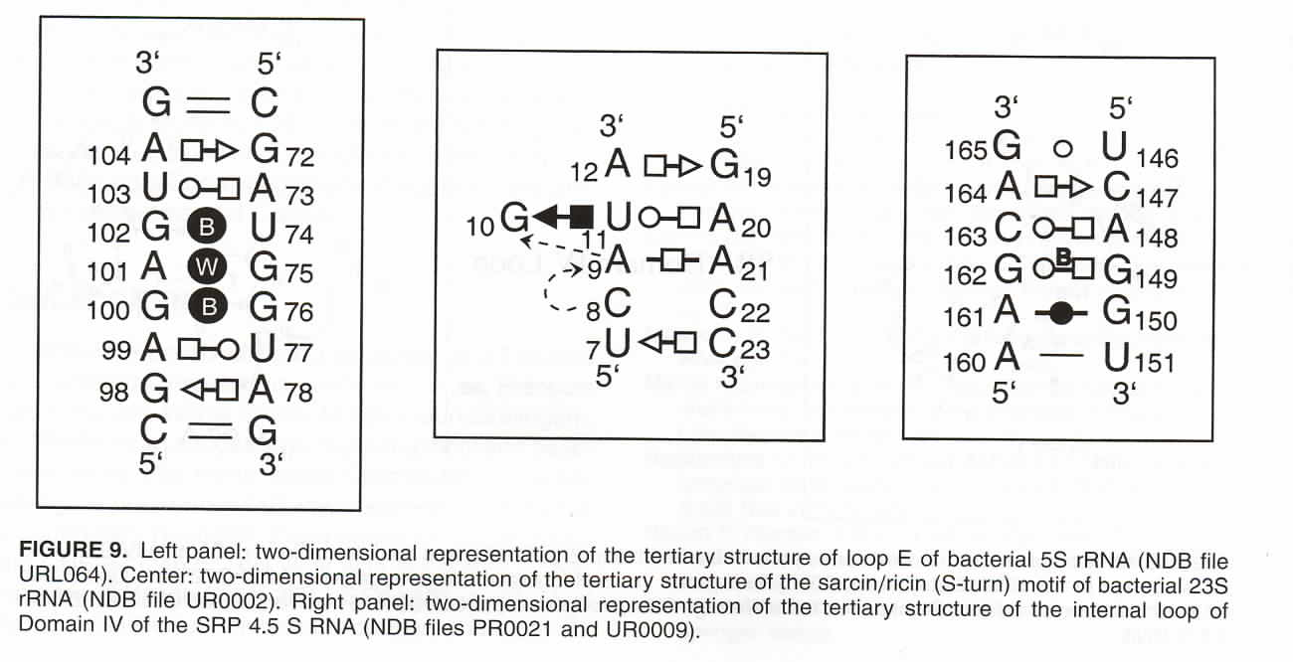

Slide 23
RNA uses chemically modified bases

Slide 24
conformational selection
vs.
induced fit
(in helix recognition)

Slide 25
are the force fields reliable?
(free energetics, sampling, dynamics)
all tetraloops
NMR structures
of DNA & RNA
crystal
simulations
RNA motifs
quadruplexes
RNA-drug interactions
Computer power?
experimental ☺
energy
What we typically find if we run long enough…
vs.
“reaction coordinate”

Slide 26
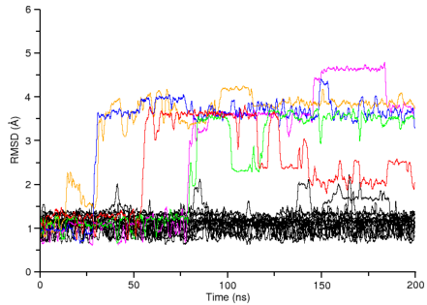
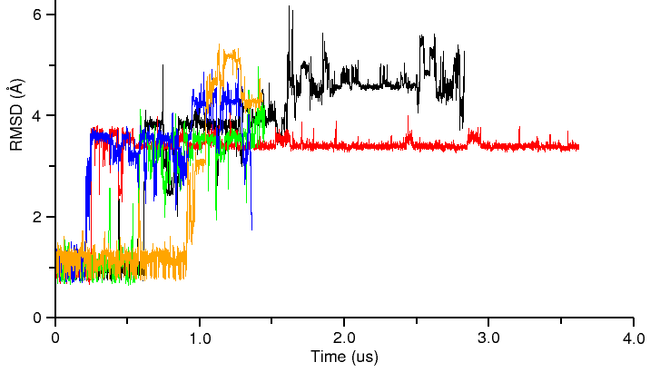
100 independent simulations of 2KOC “UUCG” tetraloop
…longer runs…
Limited sampling & too complex:
Is there a simpler set of systems?

Slide 27
Convergence as a function of time

Slide 28
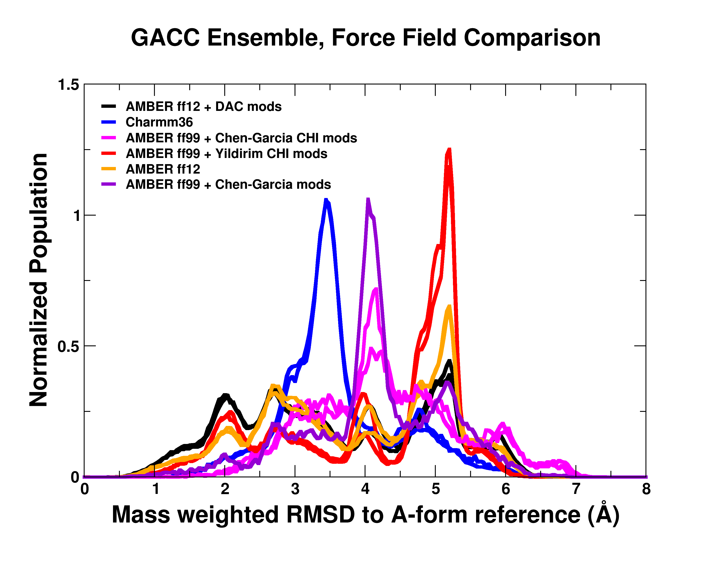

Slide 29
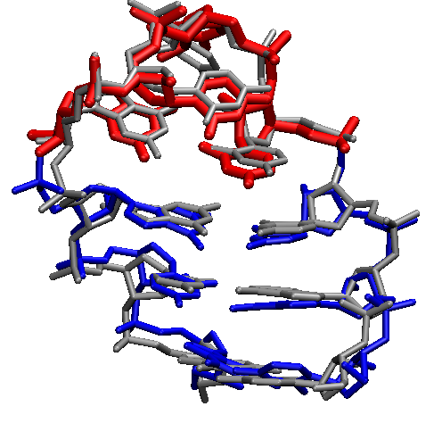
We can converge a tetranucleotide!
How about a RNA tetraloop?

Slide 30
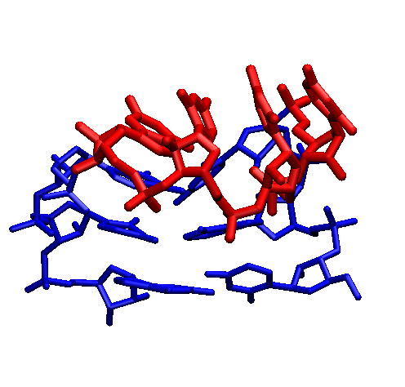

Slide 31
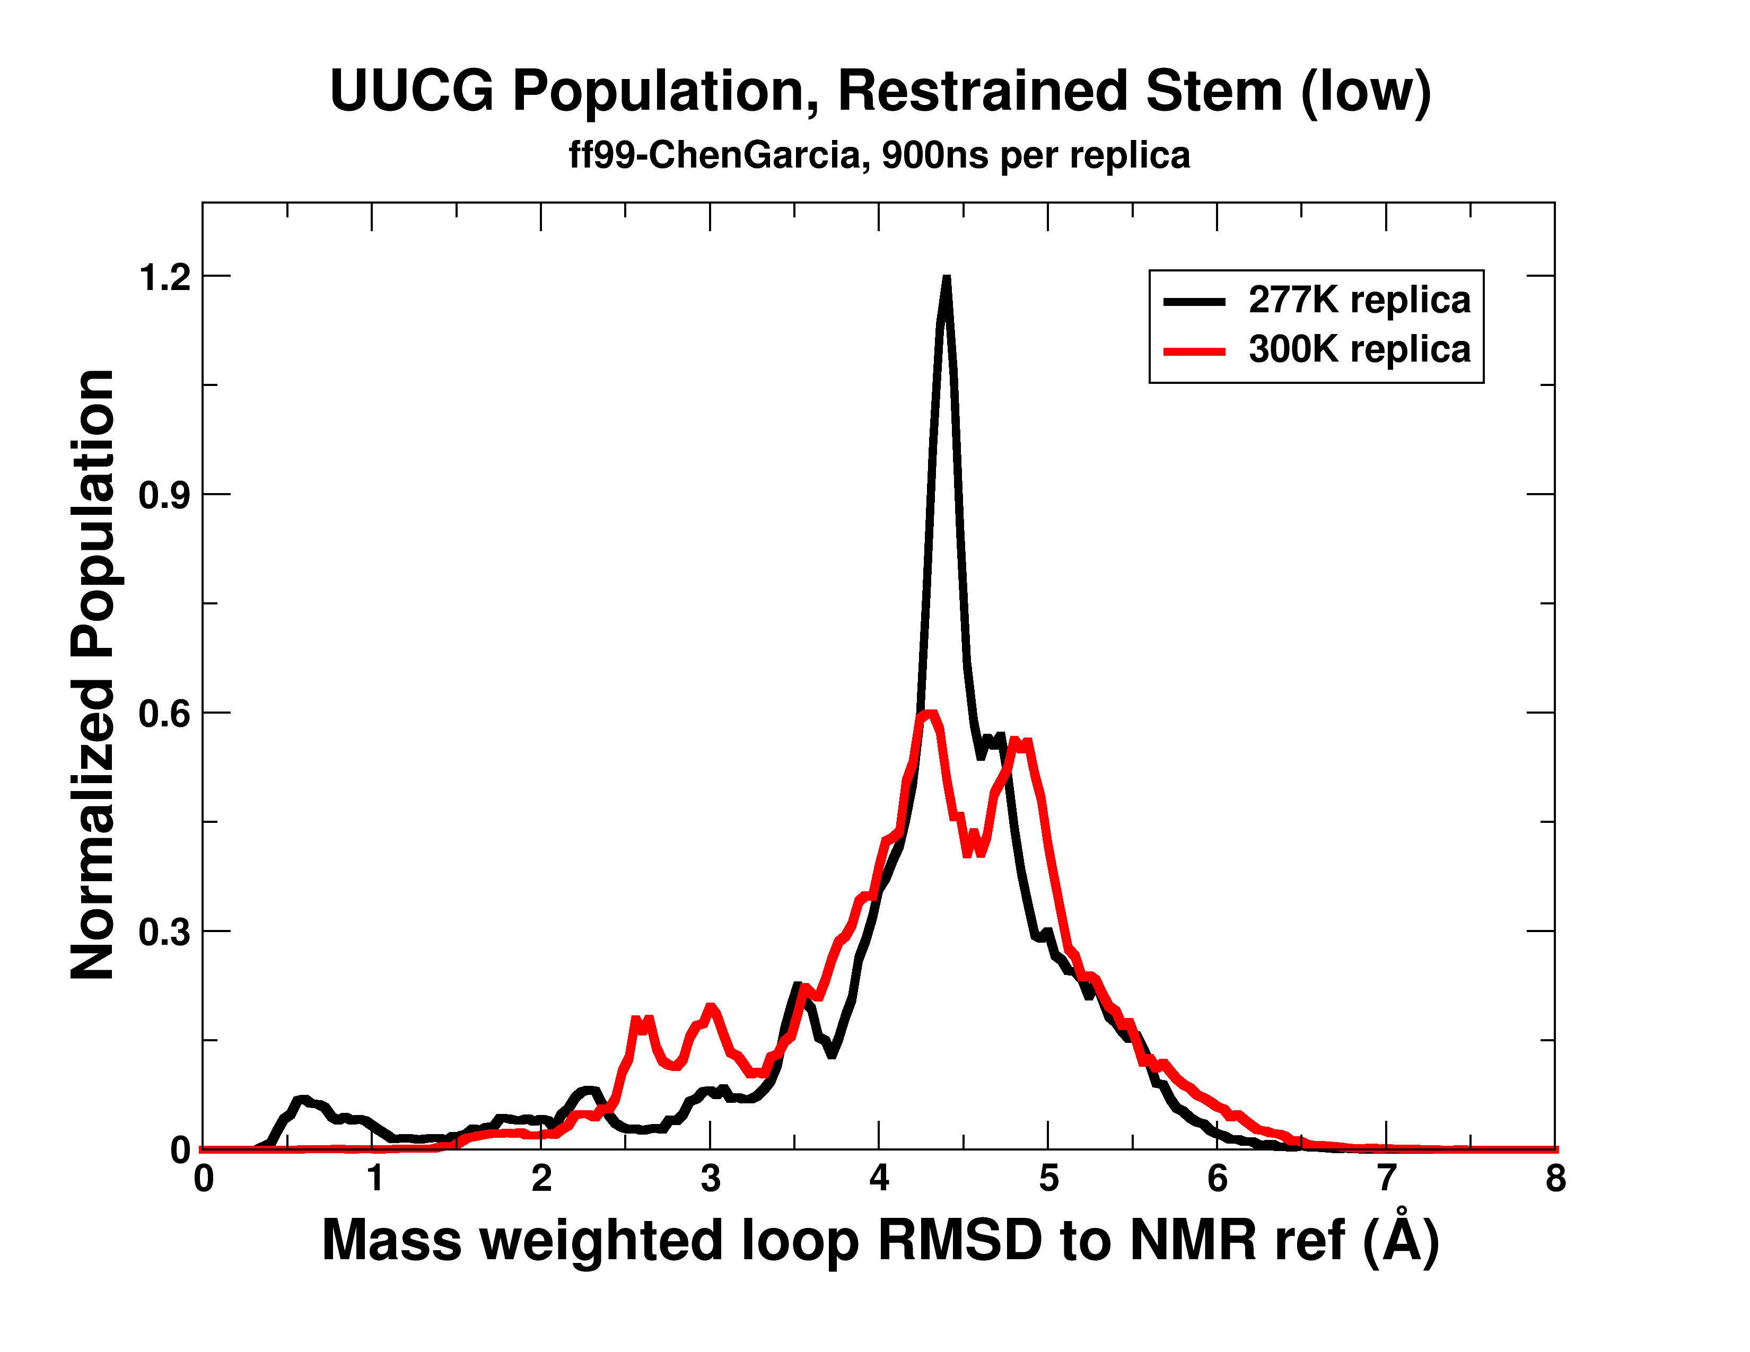

Slide 32
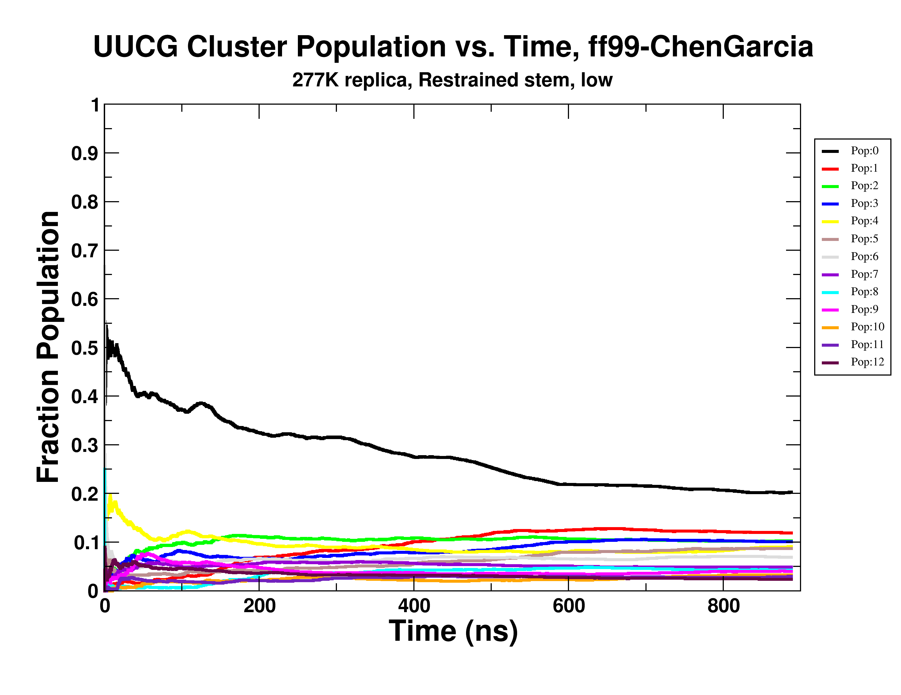

Slide 33
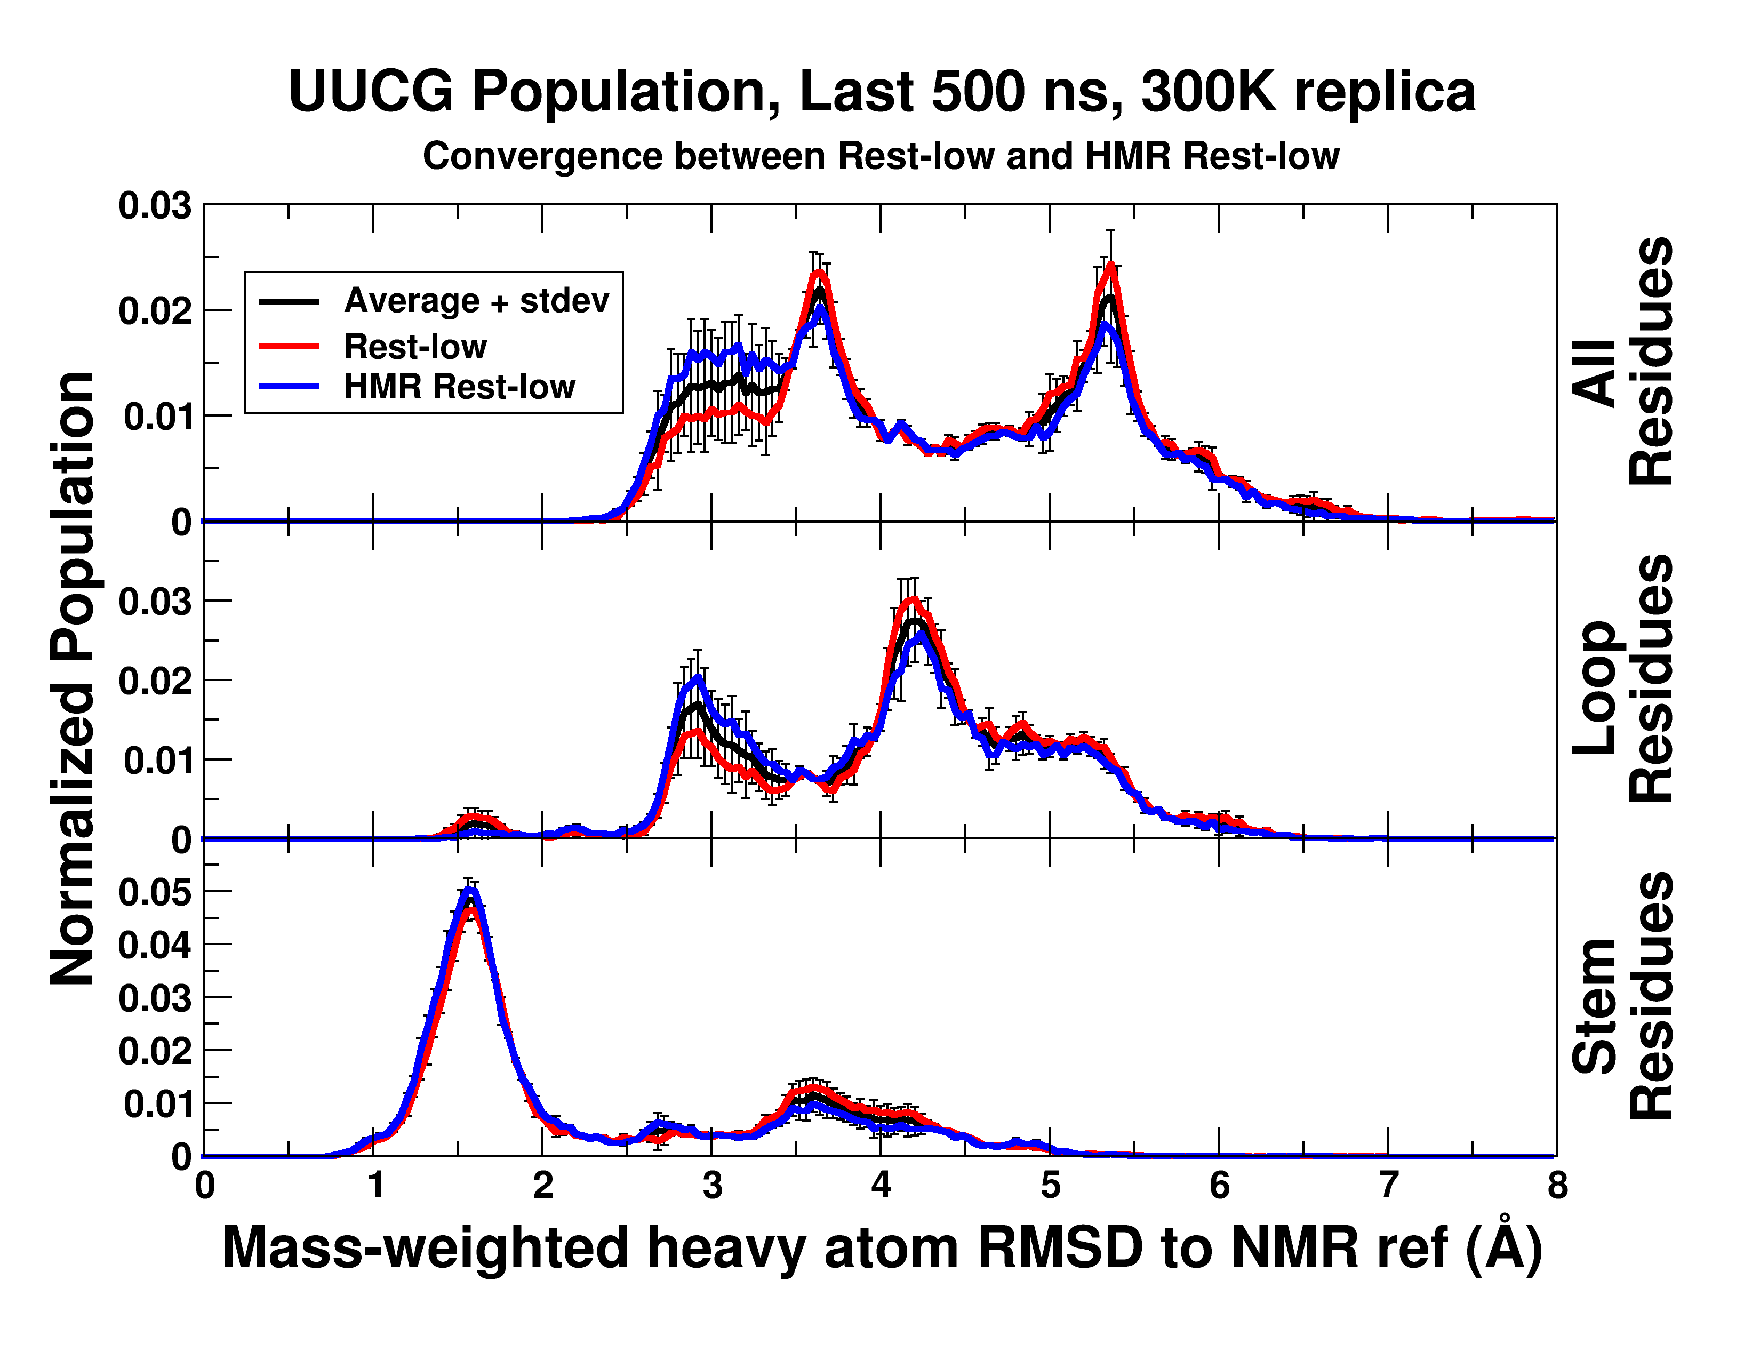

Slide 34
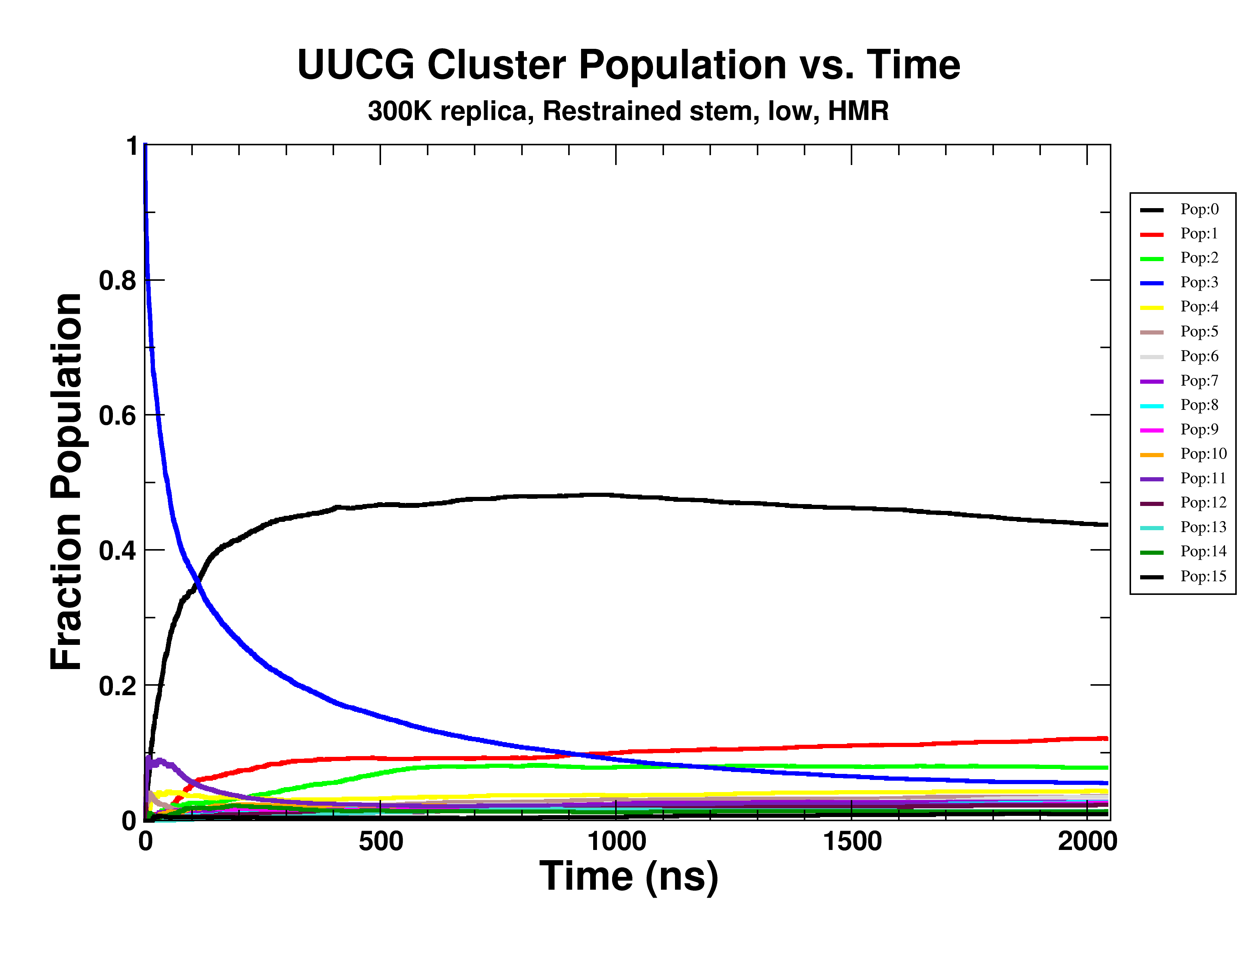

Slide 35
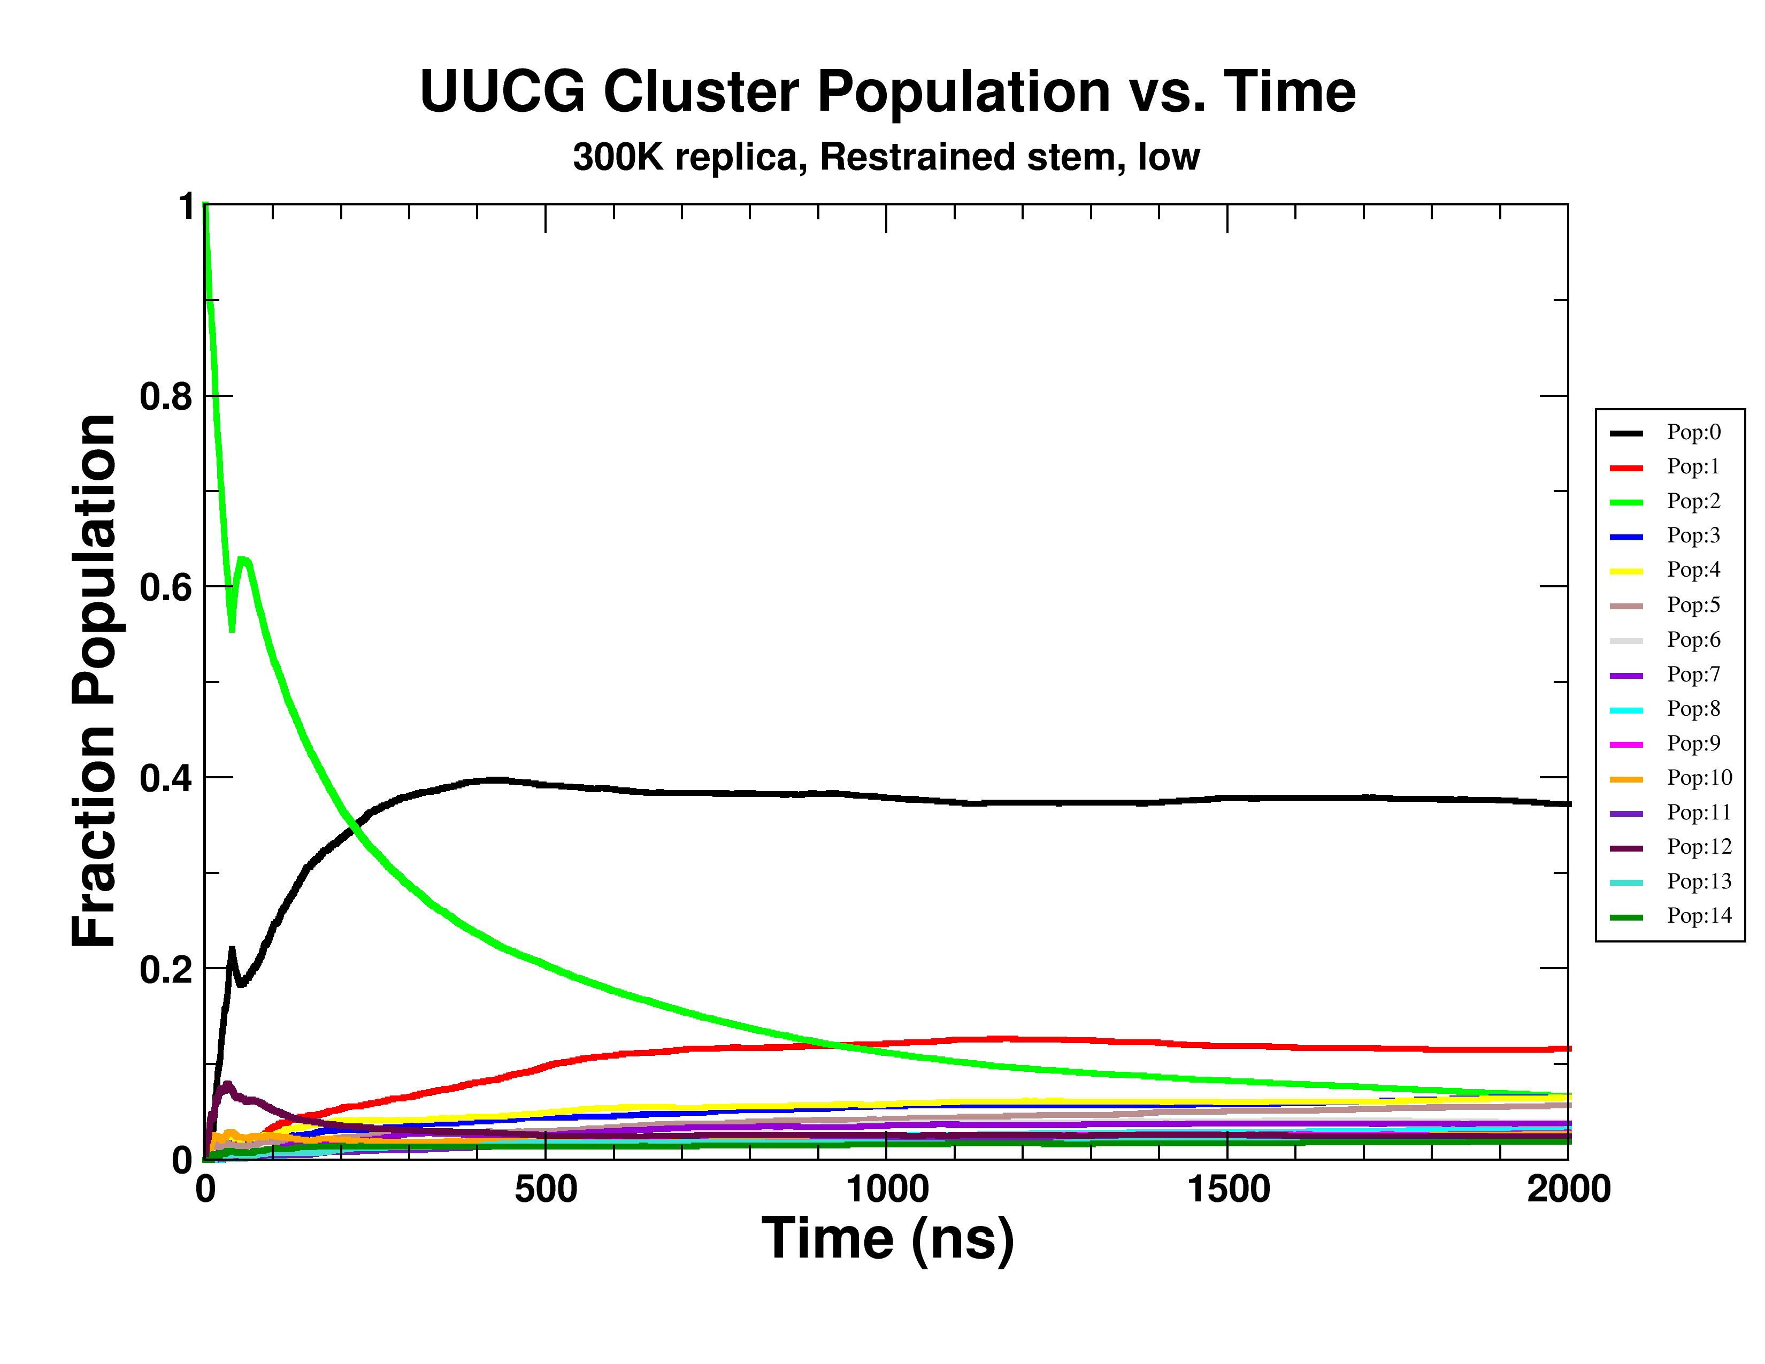

Slide 36
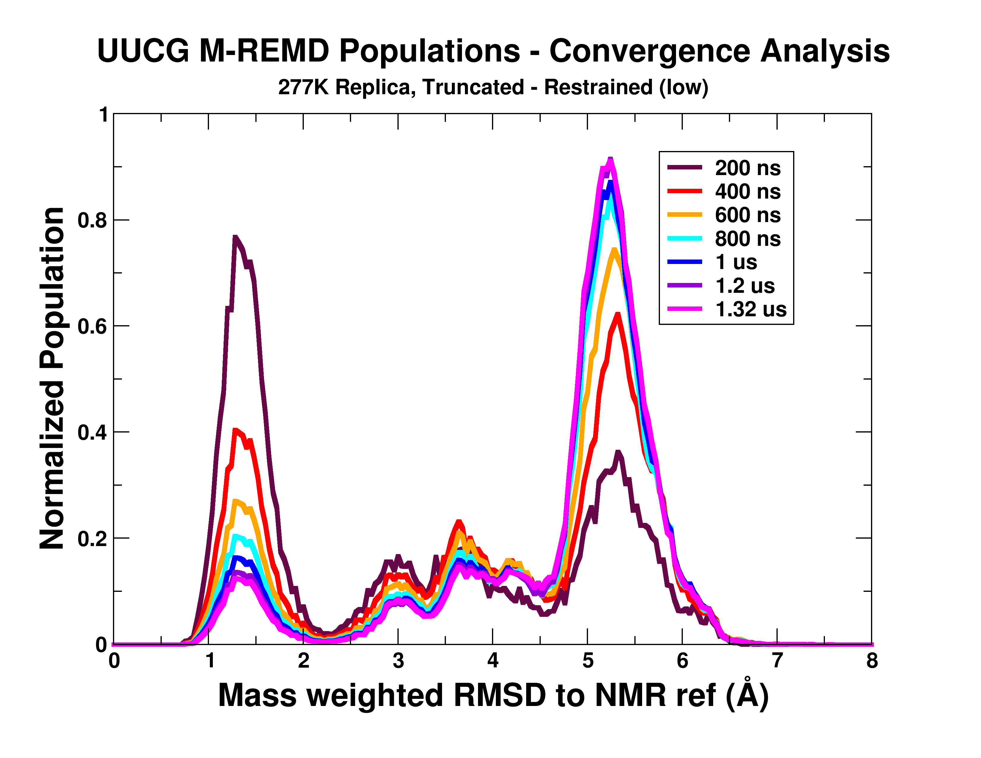

Slide 37
Tutorial time!

