Slide 1
Dealing with Non-standard Residues in AMBER

Slide 2
Parameters for Standard Residues
AMBER14 comes with a set of force fields encompassing several standard residues that have already been parameterized:
Various parameters for Proteins, DNA, and RNA
FF12SB, FF14SB
Different water models, ions, solvents
TIP3P, TIP4P
Parameters of sugars
GLYCAM
Parameters for Lipids
Lipid14

Slide 3
Programs that Aid in Generating Parameters
Antechamber
(+GAFF) Good for parameterizing most organic molecules
C, N, O, S, P, H, F, Cl, Br, I etc.
The main driver
atomtype, sqm, bondtype, am1bcc, espgen
Metal Center Parameter Builder (MCPB)
Used for parameterizing proteins with metal centers
Paramfit
Helpful in parameterizing missing torsion parameters or if existing parameters are inadequate

Slide 4
Steps to Building Parameters for Non-standard Residues
Define a topology
Select atom types
Calculate partial charges
Check for missing force field parameters
2-Chloro-Benzyl alcohol

Slide 5
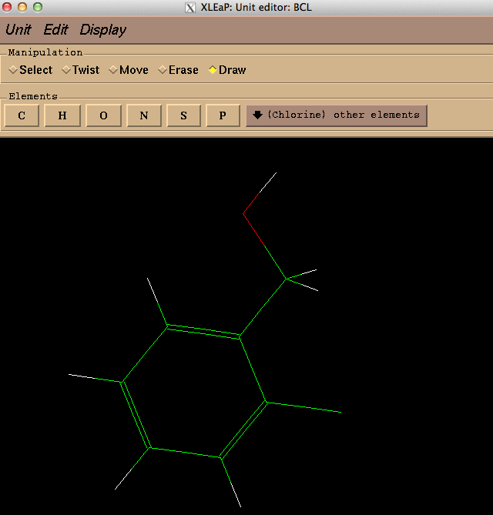
Define a topology
Draw the molecule in xleap
(or your choice of editor)
$xleap
>createResidue MOL
>edit MOL
>savepdb MOL MOL.pdb

Slide 6
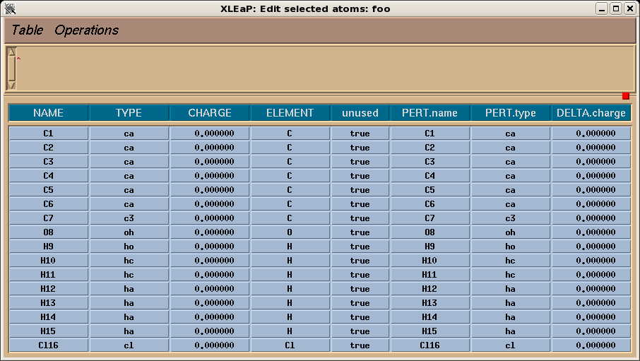
Select atom types
The GAFF force field
Designed for compatibility with the Amber protein forcefields,
Uses lower case atom types.
Exception Metal types
3 different types of hydrogen
2 different types of carbon
$>antechamber –i MOL.pdb –fi pdb –o MOL.mol2 –fo mol2

Slide 7
Calculating Partial Charges
Charge Models
AM1-BCC (AM1 w/ Bond Corrected Charges)
Charges are derived from semi-empirical calculations
RESP (Restrained Electrostatic Potential)
Charges derived from QM calculations
HF/6-31G* [ iop(6/33=2) ]
Example:
$>antechamber –i MOL.log –fi gout –o MOL.charg.mol2 –fo mol2 –c resp

Slide 8
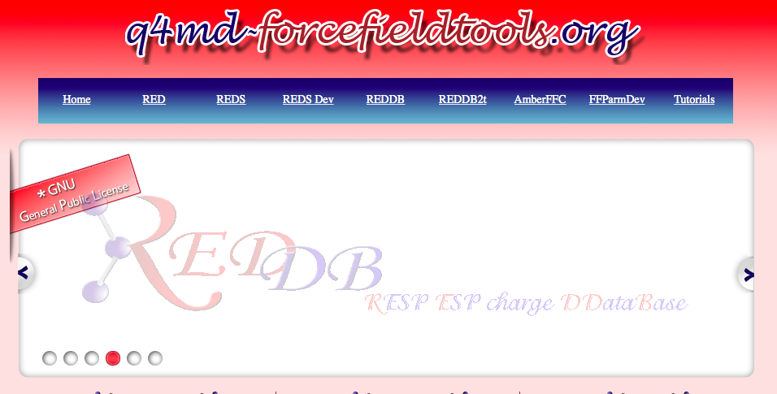

Slide 9
Check for Missing Force Field Parameters
The program parmchk can be used to check for missing parameters:
Bond, Angles, Dihedrals, etc.
$>parmchk –i Mol.mol2 –o Mol.frcmod –f mol2
remark goes here
MASS
BOND
ANGLE
DIHE
IMPROPER
ca-ca-ca-ha 1.1 180.0 2.0 General improper torsional angle (2 general atom types)
NONBON
"ATTN: NEEDS REVISION”
You need to provide the parameters
ca-ca-f -ca 1 0.000 0.000 0.000 ATTN, need revision (Example Only)

Slide 10
Build a Library File
!!index array str
"MOL"
!entry.MOL.unit.atoms table str name str type int typex int resx int flags int seq int elmnt dbl chg
"C1" "ca" 0 1 131072 1 6 -0.080300
"C2" "ca" 0 1 131072 2 6 -0.096000
"C3" "ca" 0 1 131072 3 6 -0.131000
"C4" "ca" 0 1 131072 4 6 -0.122000
"C5" "ca" 0 1 131072 5 6 -0.126000
"C6" "ca" 0 1 131072 6 6 0.015400
"C7" "c3" 0 1 131072 7 6 0.174700
"O8" "oh" 0 1 131072 8 8 -0.600800
"Cl9" "cl" 0 1 131072 9 6 -0.102400
"H10" "ha" 0 1 131072 10 1 0.160000
"H11" "ha" 0 1 131072 11 1 0.137000
"H12" "ha" 0 1 131072 12 1 0.136000
"H13" "ha" 0 1 131072 13 1 0.146000
"H14" "h1" 0 1 131072 14 1 0.041700
"H15" "h1" 0 1 131072 15 1 0.041700
"H16" "ho" 0 1 131072 16 1 0.406000
#create LIB file
source leaprc.gaff
MOL=loadmol2 BCL.mol2
loadamberparams BCL.frcmod
saveoff MOL MOL.lib
Check MOL
Completely defines a molecule in AMBER terms: atom types, charges, default geometries

Slide 11
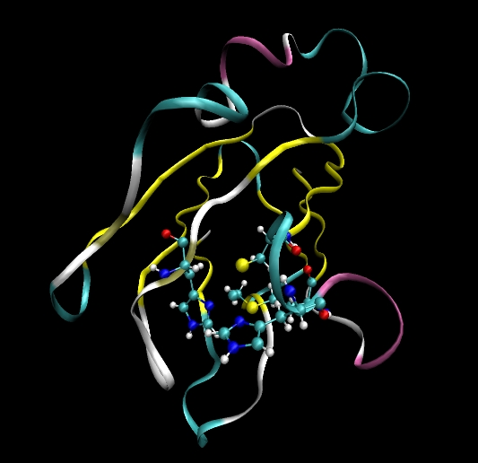
Non-Standard Residues in Protein
Example
Plastocyanin (1PLC.pdb)
Involved in electron transfer
Cu⁺ is coordinated by HIS, CYS, MET
Assuming no change in AA bound to the Cu⁺ ion
Cu⁺, single fixed charged

Slide 12
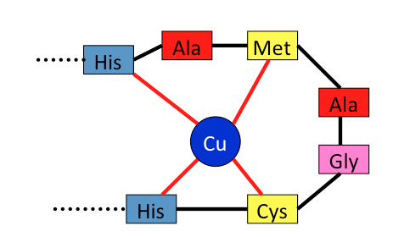
Format the PDB
To Do List
Resolve alternate conformations
ALYS
BLYS
By default LEaP only uses the “A” conformations
Rename residues bound to Cu⁺
HIS → HIE
Proton placed on epsilon nitrogen
CYS → CYM
Deprotonated form CYS

Slide 13
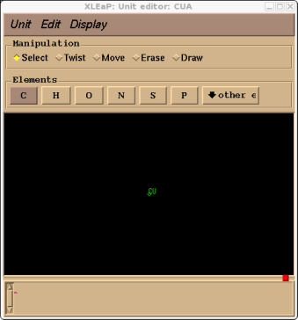
Build the Copper Residue Library
copy the Cu into its own "pdb":
HETATM 1548 CU CUA 100 7.050 34.960 18.716 1.00 8.78 1PLC1671
Load the pdb into xleap and edit the single atom in it and save the unit as a library file:
cua = loadpdb cu.pdb
edit cua
saveoff cua cua.lib

Slide 14
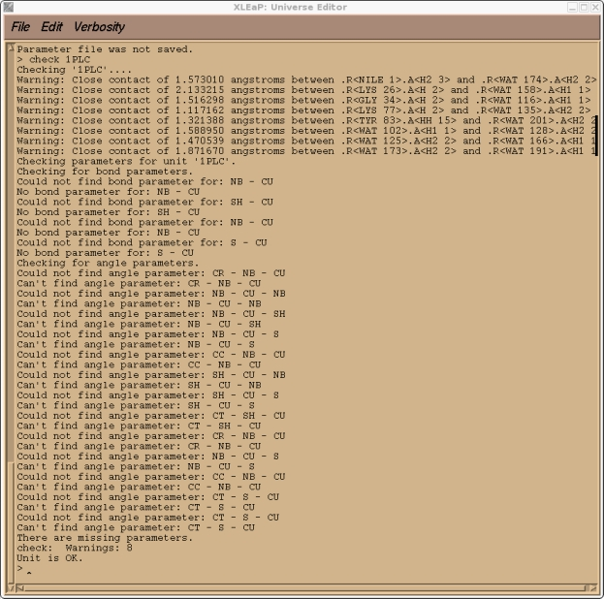
Check for Missing Parameters
> loadoff cua.lib
> prot = loadpdb protein_cu_complex.pdb
> bond prot.37.ND1 prot.100.CU
> bond prot.87.ND1 prot.100.CU > bond prot.84.SG prot.100.CU > bond prot.92.SD prot.100.CU
> check prot

Slide 15
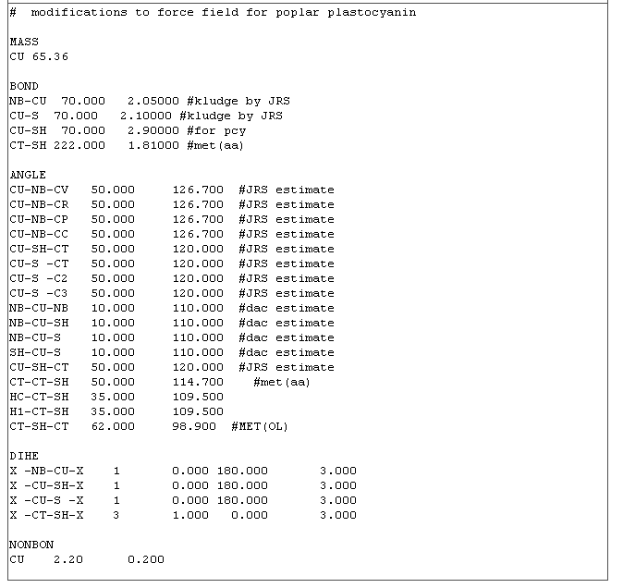
Provide Parameters via Frcmod File
- Define a copper atom
(including vdw parameters)
- Provide bond, angle constants
for all Cu 1-2, 1-3 interactions
Only very simple dihedrals are provided
>loadoff cua.lib >loadamberparams cua.frcmod
> prot = loadpdb protein_cu_complex.pdb
> bond prot.37.ND1 prot.100.CU
> bond prot.87.ND1 prot.100.CU > bond prot.84.SG prot.100.CU > bond prot.92.SD prot.100.CU
> solvateoct prot TIP3PBOX 12
> addions prot Na+ 0
> saveamberparm prot prot.prm prot.rst

Slide 16
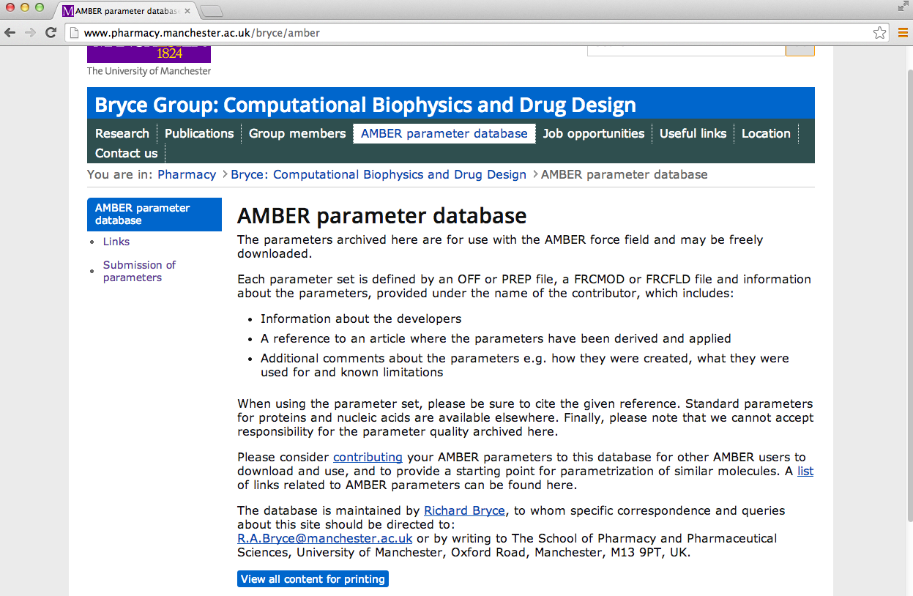
Parameter Database
http://www.pharmacy.manchester.ac.uk/bryce/amber/
Contains Parameters for several:
Cofactors, Organic Molecules, Ions, Solvents Boxes, etc.
Do not just download their parameters and begin running MD, check their validity

Slide 17
Parmed.py
Generates a Lib or Frcmod file from a topology file:
Helpful when the parameters of a particular system have been misplaced.
>Parmed.py prmtop parmed.in
#Generate a Lib & FRCOMD File
loadRestrt inpcrd
WriteOFF Lib
WriteFrcmod FRCMOD

Slide 18
Conclusion
There is not necessarily a correct way to build parameters but there is a wrong way
Search the literature
Justify your assumptions
Visualize the MD trajectories

